Slide 1

Analysis on the impact of coronavirus on market capitalization of sp500 companies Group 003-001 Ricardo Calleja Jose Toro Patricio Ramirez Cristian Salinas
St. Clair College Fall 2022

Slide 2
CONTENTS
Background / Motivation
Project description
Problem description
Analysis questions
Dataset description
Method

Slide 3

01.
Background / Motivation.

Slide 4

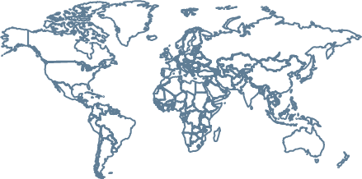
Background / Motivation.
Pandemics are recurrent (Ex. Ebola 2013, Spanish flu 1918), and they had an economic impact. The raise of economic uncertainty during Covid-19 pandemic (Ortmann et al., 2020), increased investment risk. Understanding the trend of economic actors, could be used as a comparison for similar events in the future.
Disclaimer: Even though investment risk augmented during COVID-19, it is not our intention to assure causation.

Slide 5
Background / Motivation.
Since the COVID-19 pandemic was officially declared in January 2020 , it is relevant to analyze data from the year 2019, 2020 and 2021. Considering seasonality effects, the analysis is performed on a quarterly basis.

Slide 6
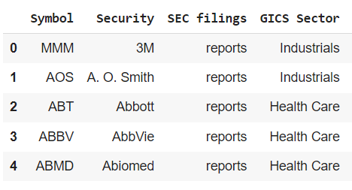
Background / Motivation.
Symbol: Mnemonic which represents the name of the company.
Security: Fungible and tradable financial instruments used to raise capital in public and private markets.
GICS Sector: Company sector according to Global Industry Classification Standard.

Slide 7
02.
Project description

Slide 8

”
Investors in SP500 index need to understand tendencies on market capitalization before, during and after pandemics, in order to use it as a point of comparison for similar events in the future.
*Before refers to all quarters of 2019. *During refers to all quarters of 2020. *After refers to all quarters of 2021.

Slide 9
03.
Problem description

Slide 10

Problem DESCRIPTION
Create a descriptive analysis to comprehend the market capitalization value of the companies that belong to the SP500 index in the year 2019, 2020 and 2021 by quarters.

Slide 11
04.
Analysis Questions

Slide 12

1) How each GICS sector in the sp500 index performed in market capitalization terms ON ALL QUARTERs OF 2019, 2020 AND 2021? 2) WHICH WAS THE TOP COMPANY in the sp500 index WITH HIGHER POSITIVE MARKET CAPITALIZATION FOR ALL QUARTERs OF 2019, 2020 AND 2021?

Slide 13
1) How each GICS sector in the sp500 index performed in market capitalization terms FOR THE PERIOD 2020-2019?
For 2020-2019 the GICS sector in the SP500 index with higher positive variation on market capitalization WAS INFORMATION TECHNOLOGY with 34%.

Slide 14
1) How each GICS sector in the sp500 index performed in market capitalization terms for the PERIOD 2021-2020?
For 2020-2021 the GICS sector in the SP500 index with higher positive variation on market capitalization WAS ENERGY with 55%.

Slide 15
2) WHICH WAS THE TOP COMPANY in the sp500 index WITH HIGHER POSITIVE MARKET CAPITALIZATION FOR ALL QUARTER OF 2019, 2020 AND 2021?
 | Q1 | Q2 | Q3 | Q4
2019 vs 2020 | XXX =XXX% | XXX =XXX% | XXX =XXX% | XXX =XXX%
2020 vs 2021 | Tesla =537% | XXX =XXX% | XXX =XXX% | XXX =XXX%

Slide 16
05.
Dataset Description

Slide 17
Dataset Description
1) The dataset to be used comes from Yahoo Finance API and it includes stock price, share quantity and a description of each company within the SP500.
2) It covers all quarters from 2019, 2020 and 2021.

Slide 18
06.
METHOD

Slide 19

METHOD
Merge Dataset
Clean Database
ANALYZE Database
Visualizations
1
2
3
4
Consolidate the datasets: SP500 companies, Shares S&P 500,.
Analyze the data before coming to any assumption
Clean the data that can generate negative effects on the final result

Slide 20
Data Transformation
For each company of the SP500 index we joined the data for the year 2019, 2020 and 2021 by quarters. After this, Market capitalization was calculated (Share price times Share Volume). Additionally, we found Market capitalization variation for the period 2020 vs 2019 and 2021 vs 2020. Finally, the data was also analyzed by GICS sector.

Slide 21
07.
Exploratory Data Analysis (EDA)

Slide 22
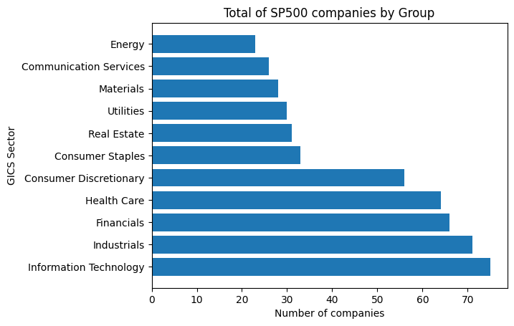
EDA
SP500 index is composed by 503 companies, divided on 11 Sectors, Lead by Information Technology, Industrials and Financial companies.

Slide 23
CONCLUSION
SP500 index is composed by 503 companies, divided on 11 Sectors, Lead by Information Technology, Industrials and Financial companies.

Slide 24
RECOMENDATIONS
SP500 index is composed by 503 companies, divided on 11 Sectors, Lead by Information Technology, Industrials and Financial companies.

Slide 25
REFERENCE
1. Ortmann, R., Pelster, M., & Wengerek, S. T. (2020). COVID-19 and investor behavior. SSRN Electronic Journal. https://doi.org/10.2139/ssrn.3589443

